Slide 1



SESSION NAME HERE
LINEAR DATA STRUCTURES (Part 1)

Slide 2


Foundational Sessions Housekeeping
The use of disrespectful language is prohibited in the questions, this is a supportive, learning environment for all - please engage accordingly. (FBV: Mutual Respect.)
No question is daft or silly - ask them!
There are Q&A sessions midway and at the end of the session, should you wish to ask any follow-up questions. Moderators are going to be answering questions as the session progresses as well.
If you have any questions outside of this lecture, or that are not answered during this lecture, please do submit these for upcoming Open Classes. You can submit these questions here:
SE Open Class Questions or DS Open Class Questions

Slide 3
Foundational Sessions Housekeeping cont.
For all non-academic questions, please submit a query: www.hyperiondev.com/support
Report a safeguarding incident: www.hyperiondev.com/safeguardreporting
We would love your feedback on lectures: Feedback on Lectures

Slide 4


Reminders!
Guided Learning Hours
By now, ideally you should have 7 GLHs per week accrued. Remember to attend any and all sessions for support, and to ensure you reach 112 GLHs by the close of your Skills Bootcamp.
CONFIDENTIAL

Slide 5
Progression Criteria
✅ Criterion 1: Initial Requirements
Complete 15 hours of Guided Learning Hours and the first four tasks within two weeks.
✅ Criterion 2: Mid-Course Progress
Software Engineering: Finish 14 tasks by week 8.
Data Science: Finish 13 tasks by week 8.
✅ Criterion 3: Post-Course Progress
Complete all mandatory tasks by 24th March 2024.
Record an Invitation to Interview within 4 weeks of course completion, or by 30th March 2024.
Achieve 112 GLH by 24th March 2024.
✅ Criterion 4: Employability
Record a Final Job Outcome within 12 weeks of graduation, or by 23rd September 2024.
CONFIDENTIAL

Slide 6

Linear Data Structures
Linked Lists
Arrays

Slide 7

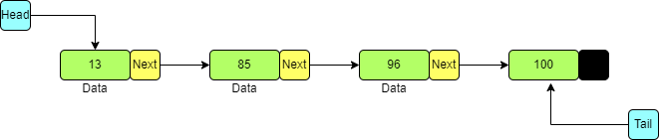
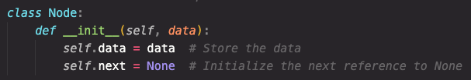
Linked Lists (Never Lose the head!)
A singly linked list is a collection of nodes, where each node contains data and a reference to the next node.

Slide 8
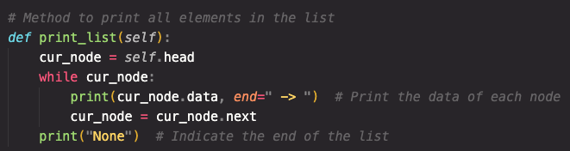
Traversing the List
Traversing means visiting each node, starting from the head.
It's used for operations like printing the list's contents.

Slide 9
Prepending Elements

Slide 10
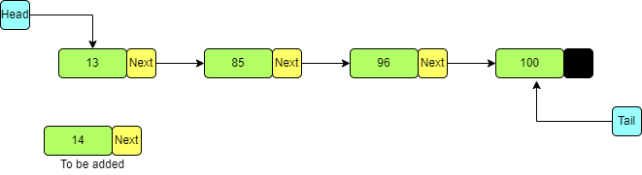
Prepending Elements

Slide 11
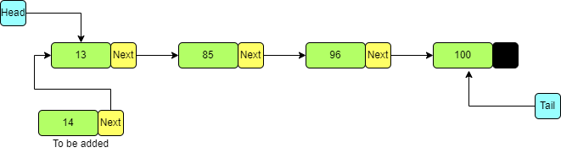
Prepending Elements

Slide 12
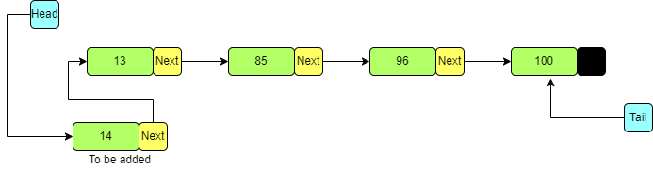
Prepending Elements
Prepending inserts a new node at the beginning.
It's an efficient operation, setting the new node as the head.

Slide 13
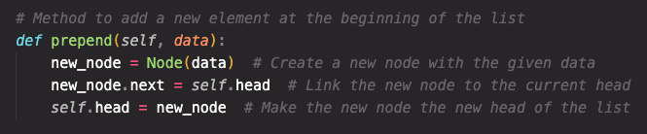
Prepending Elements
Prepending inserts a new node at the beginning.
It's an efficient operation, setting the new node as the head.

Slide 14
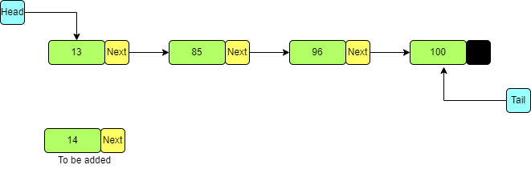
Appending Elements

Slide 15
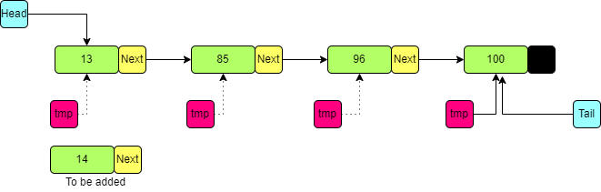
Appending Elements

Slide 16
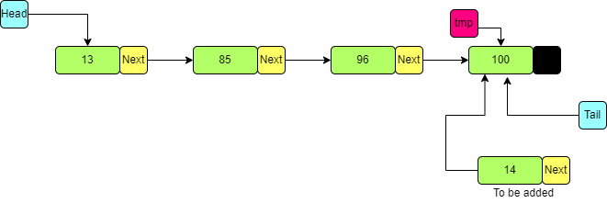
Appending Elements

Slide 17
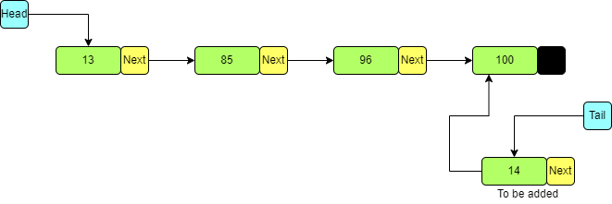
Appending Elements

Slide 18
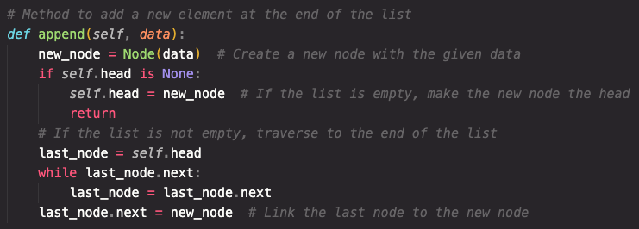
Appending Elements
Appending adds a new node at the end of the list.
We traverse to the list's end and link the last node to the new one.

Slide 19

Arrays
Arrays are a fixed size data structure for storing elements in a contiguous memory location.
Contiguous: Next to or in sequence in memory.
They allow fast access to elements using indices.
Arrays are of fixed size, and resizing them requires creating a new array.
Python arrays are actually lists, so they are dynamic, but numpy arrays are fixed under the hood.

Slide 20
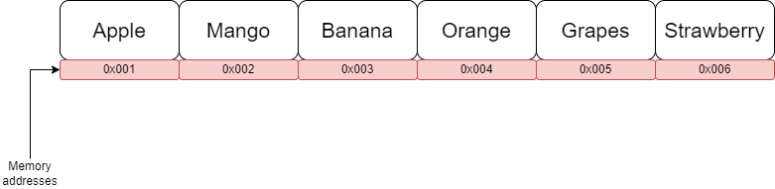
Arrays

Slide 21


Thank you
for joining us
Take regular breaks
Stay hydrated
Avoid prolonged screen time
Practice good posture
Get regular exercise
“With great power comes great responsibility”

Slide 22

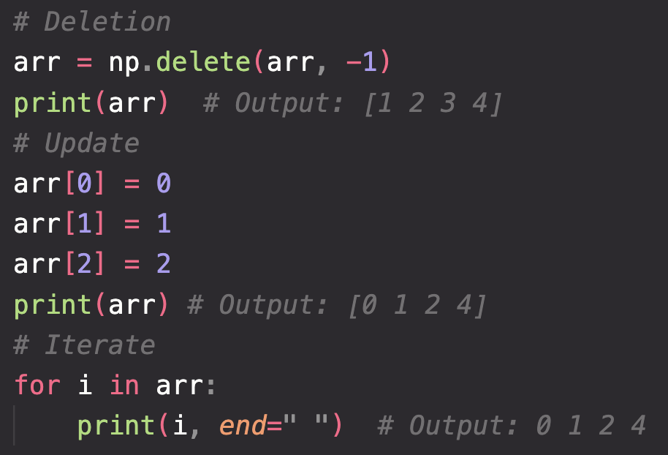
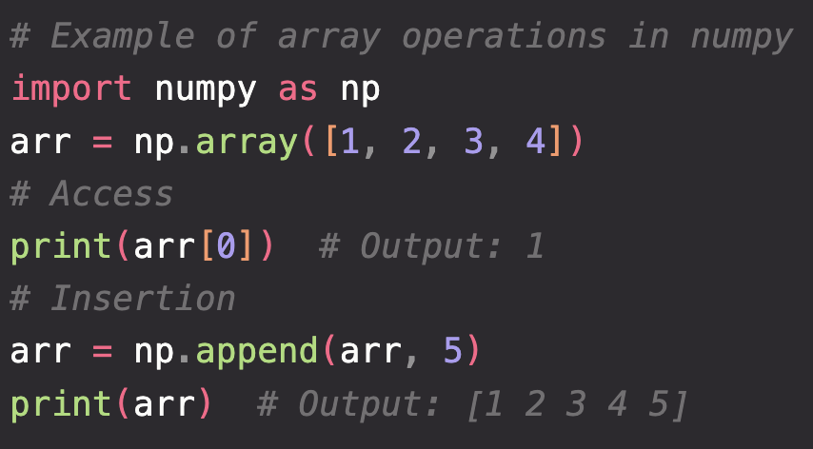
Array Operations
Questions and Answers
Common operations include accessing elements, updating values, and iterating over elements.
Questions around Linear Data Structures Part 1

